Slide 2

Digitization with cyber-physical systems
Cyber-physical systems as the driving force behind digital transformation
Ferhat Aslan

Slide 3
Workshop divided into three days:
Fist day (morning and afternoon):
Presentation and Group Work
Introduction: Digitization with cyber-physical systems
Getting Started with Raspberry Pi
Raspberry Pi GPIO and programming LED and micro switch for beginners
Second (morning) and third day (afternoon):
Practical Learning (Soldering + Networking)
Introduction: Test Benches Remotely Controlled via Internet
Set up Cyber-physical System with RPI
Set up Network and Server with Labview
Trial and error
03.03.20
| <Foliennummer>

Slide 4
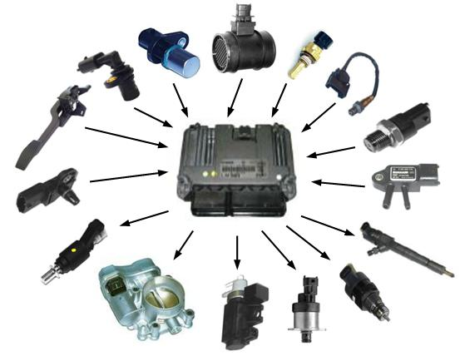
How do I record and influence physical or chemical parameters with my computer?
Example car:
03.03.20
| <Foliennummer>
http://akautomotiveservices.co.uk/training-courses-vehicle-electrics-module-3/

Slide 5
What does digitization mean?
03.03.20
| <Foliennummer>

Slide 6
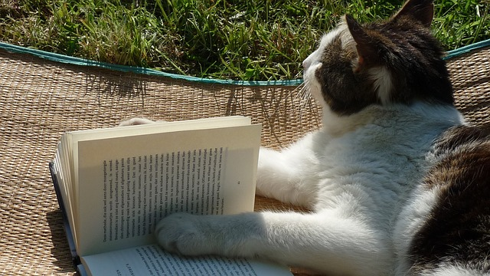



Creation of digital representations of physical objects, events or analogue media.
Digital transformation
Information of the Cat…
“Real World”
Object
“Digital World”
Object
Converting…
| <Foliennummer>
Neugebauer, Reimund. (2018). Digitalisierung: Schlüsseltechnologien für Wirtschaft und Gesellschaft. 10.1007/978-3-662-55890-4 Wikipedia - Digitization
Notes:
The Digit-Cat can used to understand Cats, the e-book can used to read the content!
<Foliennummer>

Slide 7
Digitization is bringing about so many major changes in private life and industry that it is seen as the new revolution.
Why?
03.03.20
| <Foliennummer>

Slide 8
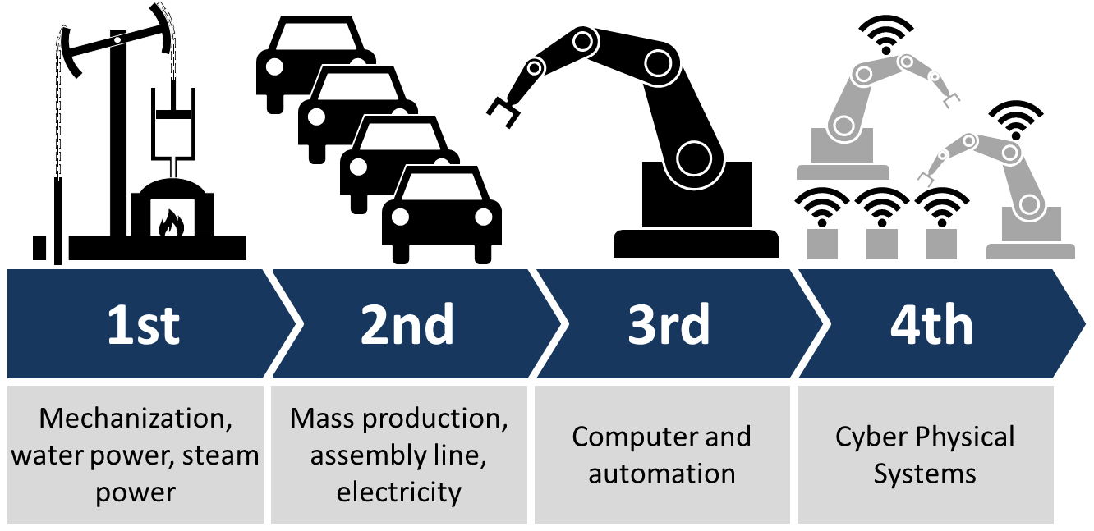
Conversion of the real information into digital! How?
Industrial revolutions and future view (Industry 4.0 - Wikipedia)
03.03.20
| <Foliennummer>

Slide 9
Definition of Cyber-physical Systems (CPS)
"... linking of real (physical) objects and processes with information processing (virtual) objects and processes via open, partly global and always interconnected information networks"
VDI (Association of German Engineers)
03.03.20
| <Foliennummer>

Slide 10
Getting Started. Let's get to know our tools!
https://projects.raspberrypi.org/en/projects/raspberry-pi-getting-started
https://tutorials-raspberrypi.de/raspberry-pi-gpio-erklaerung-beginner-programmierung-lernen/
03.03.20
| 10

Slide 11
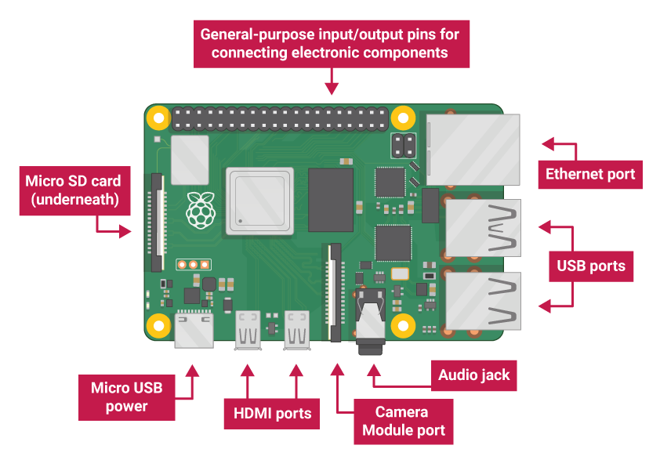
03.03.20
| 10

Slide 12
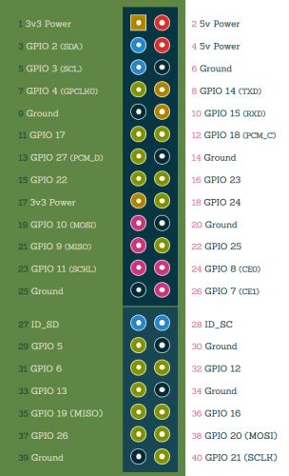
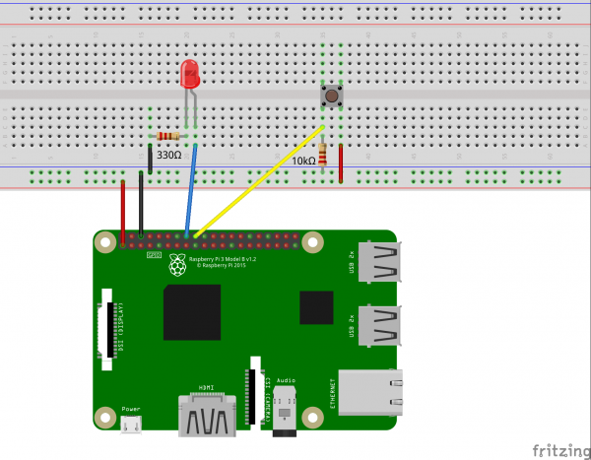
03.03.20
| 10

Slide 13
import RPi.GPIO as GPIO
import time
GPIO.setmode(GPIO.BCM)
GPIO.setup(23, GPIO.OUT)
GPIO.setup(24, GPIO.IN)
for i in range(5):
GPIO.output(23, GPIO.HIGH)
time.sleep(0.5)
GPIO.output(23, GPIO.LOW)
time.sleep(0.5)
# Loop
while True:
if GPIO.input(24) == 0:
# swith off
GPIO.output(23, GPIO.LOW)
else:
# swith on
GPIO.output(23, GPIO.HIGH
03.03.20
| 10

Slide 14
Lunch Break! See you soon…
03.03.20
| 10

Slide 15
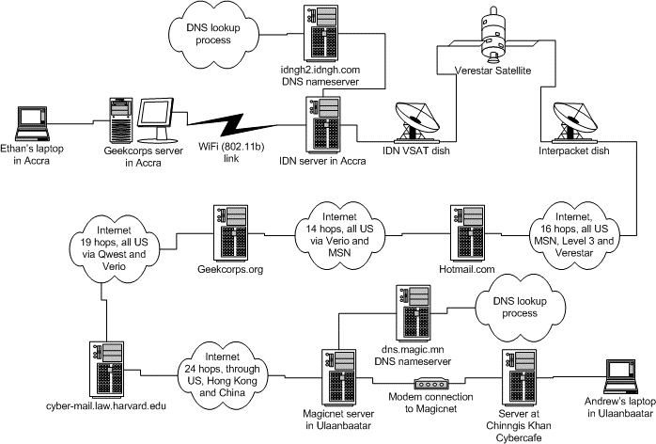
The Internet is a public space! Don't forget. What does this mean for a fail-safe and secure connection over the Internet?
Too many "computers" involved who can cut off or manipulate the data exchange!
"Around the World in 900 Milliseconds"
Here's the itinerary for Andrew's intrepid packets -- the path from his laptop to his Harvard mailserver:
1 cobalt03.mn (Magicnet Mongolia) (202.131.0.79) 2 China Satnet (203.222.194.18) 3 China Satnet (203.222.192.97) 4 SATNETEX - China Digital satNet Ltd. (203.222.192.68) 5 DigitalNetworkAlliance.GW.opentransit.net (193.251.252.230) 6 P2-1-0.HKGAR1.Hong-kong.opentransit.net (193.251.241.198) 7 P2-3.HKGBB2.Hong-kong.opentransit.net (193.251.242.189) 8 P13-0.SJOCR2.San-jose.opentransit.net (193.251.242.90) 9 P4-0.SJOCR1.San-jose.opentransit.net (193.251.242.2) 10 P5-0.NYKCR2.New-york.opentransit.net (193.251.251.225) 11 P4-0.NYKCR3.New-york.opentransit.net (193.251.242.253) 12 So2-0-0.ASHBB1.Ashburn.opentransit.net (193.251.248.177) 13 dcp-brdr-01.inet.qwest.net (205.171.209.46) 14 dca-core-01.inet.qwest.net (205.171.9.9) 15 dca-core-03.inet.qwest.net (205.171.8.218) 16 jfk-core-03.inet.qwest.net (205.171.230.6) 17 jfk-core-01.inet.qwest.net (205.171.8.19) 18 bos-core-02.inet.qwest.net (205.171.28.29) 19 bos-edge-02.inet.qwest.net (63.145.1.133) 20 Harvard router (192.5.66.5) 21 border-gw-ge-wan3-1.fas.harvard.edu (140.247.2.5) 22 core-1-gw-vl415.fas.harvard.edu (140.247.2.61) 23 core-nw-gw-vl216.fas.harvard.edu (140.247.216.1) 24 cyber-mail.law.harvard.edu (140.247.216.113)
https://cyber.harvard.edu/digitaldemocracy/internetarchitecture.html

Slide 16
How can we establish a fail-safe communication and secure connection?
Using cryptographic network protocols: SSH, HTTPS, etc.
Data integrity: Checking the correctness of the data and data structure
Develop autonomous systems related to connection breakdowns
These three points must stay in your head!

Slide 17

Cyber-physical Test Benches Remotely Controlled via Internet
03.03.20
| 10

Slide 18
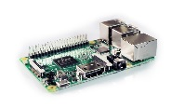
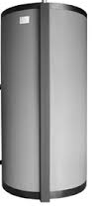
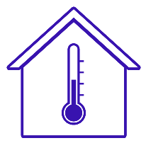

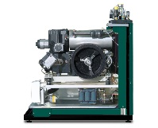
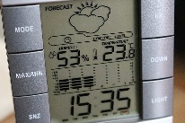
A higher goal is the networking of all cyber physical objects, which allows a collective management.
Scalable Higher-Level System
First foundations were laid with the ηNet project: https://github.com/IKKUengine/SimulatedCPSLabVIEWEnergySystem (LabVIEW, Open Source License MIT)
03.03.20
| 10

Slide 19
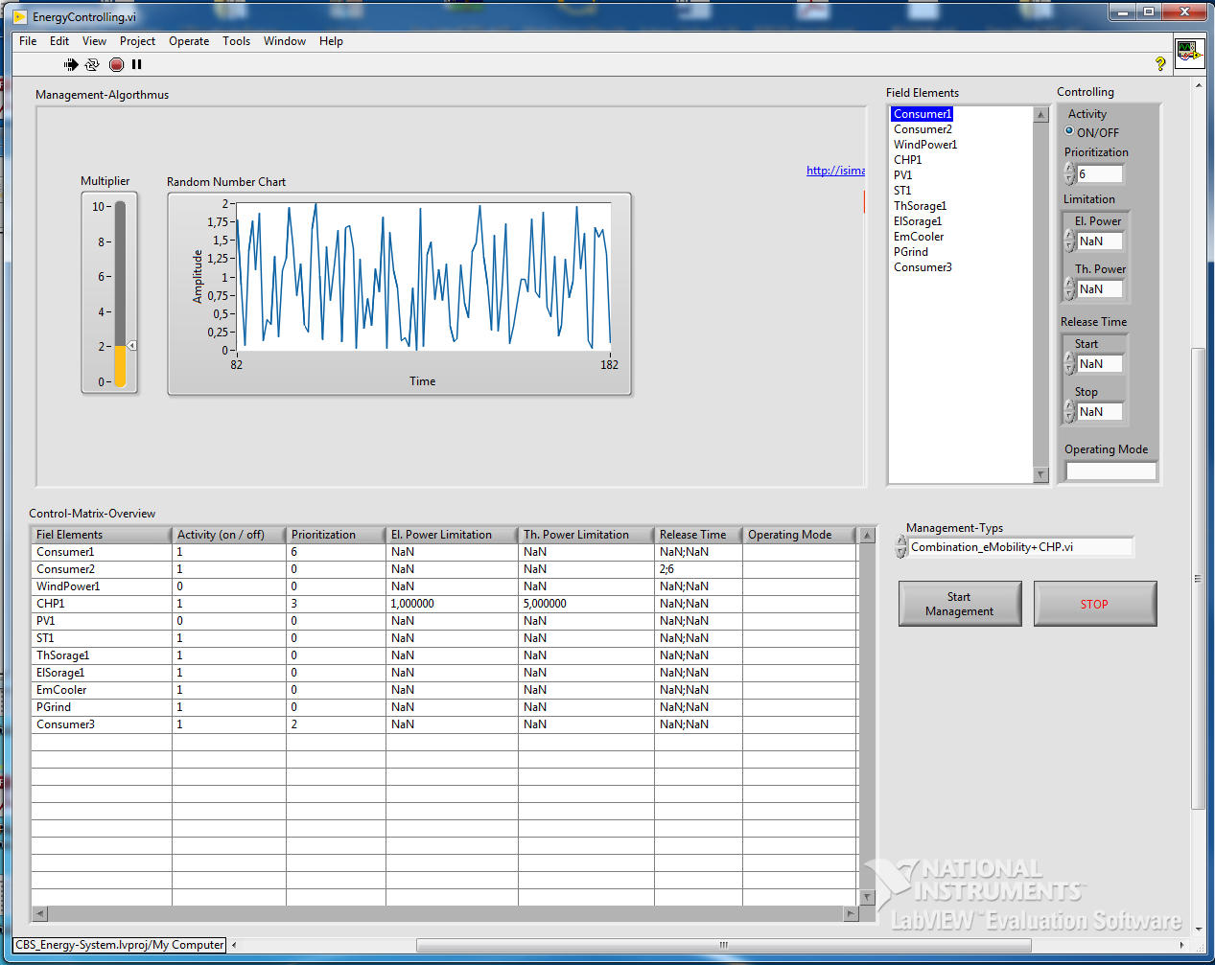
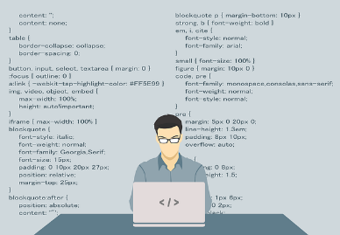
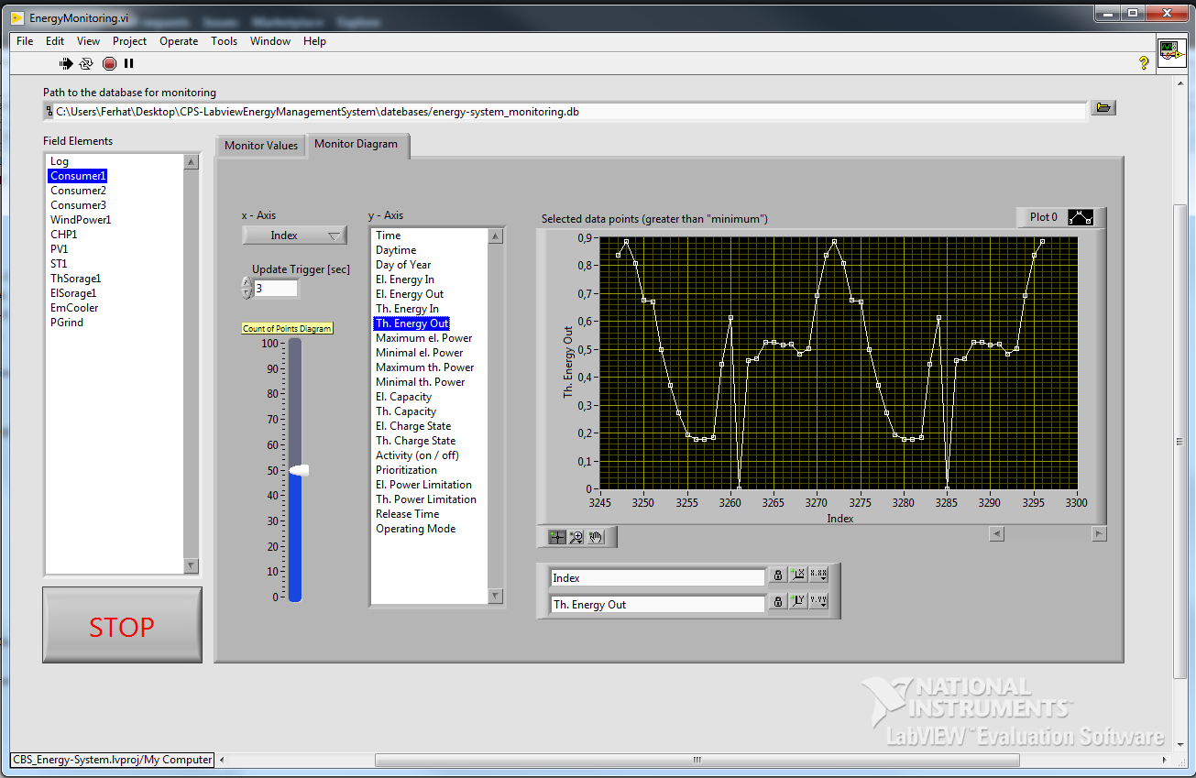
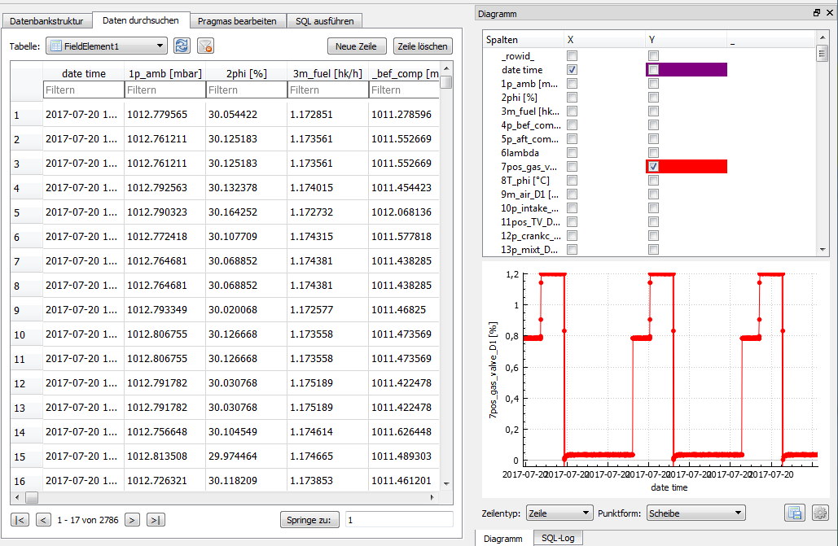


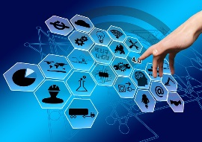

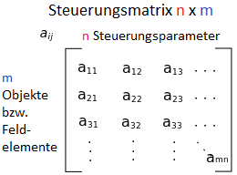
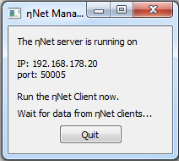
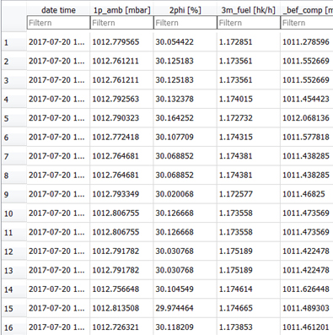
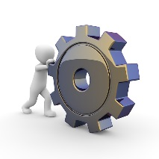
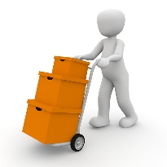
OOP-oriented Programming Paradigm
Management Interface
Monitoring
Handler
Data Collector
Cyber-Physical Objects
Producer
Consumer
Storage
Notes:
<Foliennummer>

Slide 20
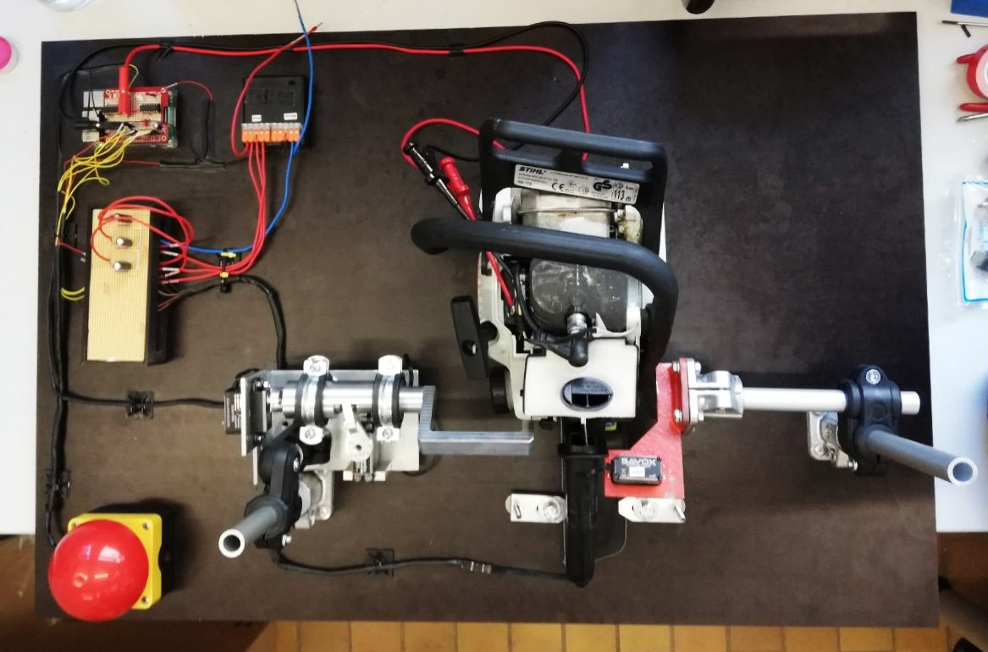
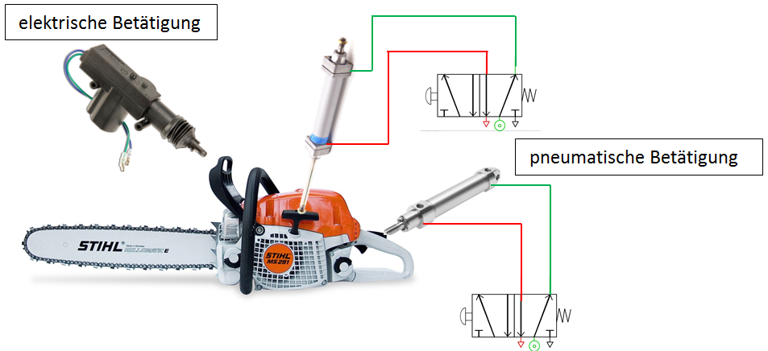
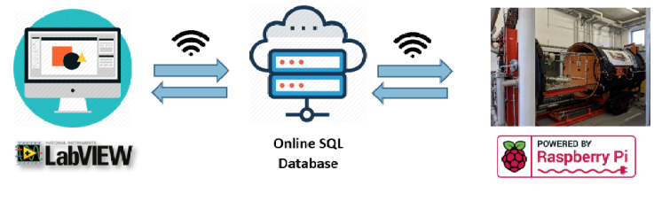
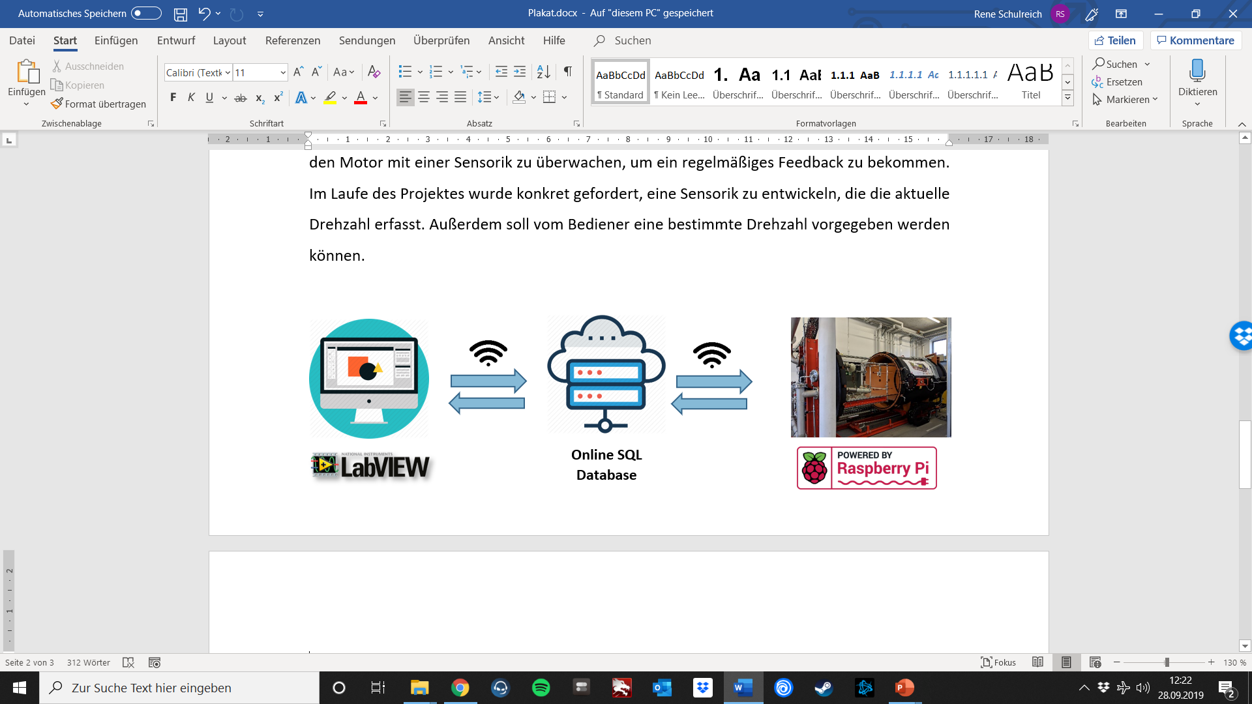
Guidelines for „Remote Control Chain Saw“ Project
Previous work (MiTOPS 2019):
Raspberry PI (clients) for controlling, data acquisition and remote control over the Internet
Servomotors as actuators
Pneumatic cylinder for rope start
With hardware operating unit
03.03.20
| 10

Slide 21
1. Project task, Group 1:
Reconstruction and development of the control system of the "mechanical controlled chain saw" via a Cloud-IoT application.
03.03.20
| 10

Slide 22
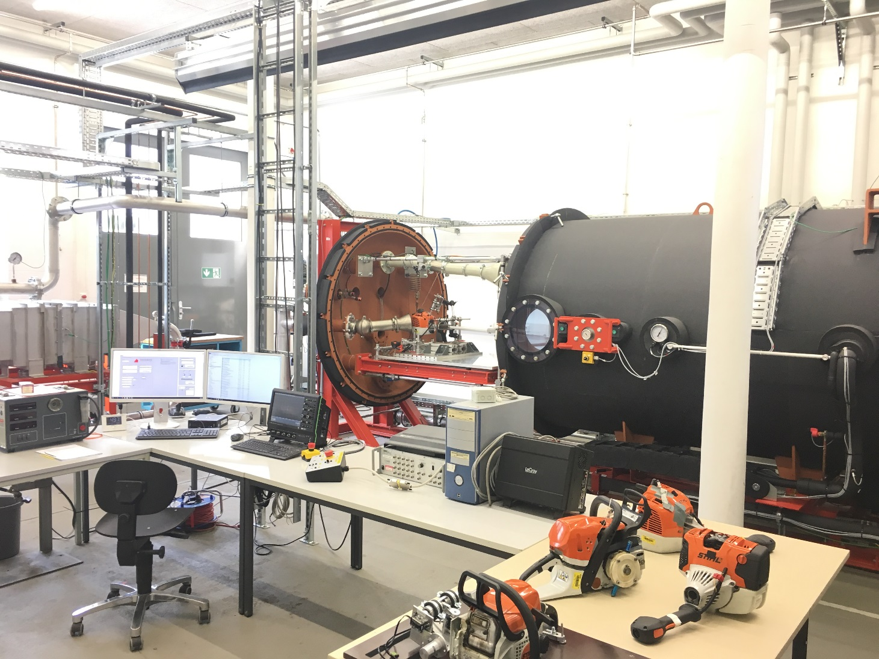
Background: Environmental Chamber
Artur Martel, Arsema Derbie, Dennis Weierter
| 10

Slide 23
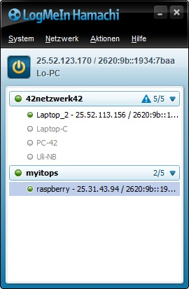
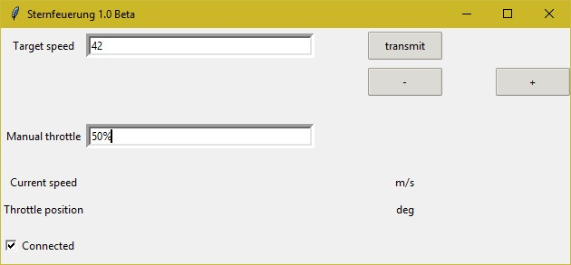

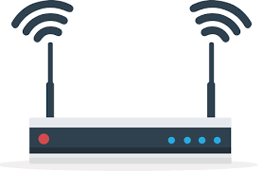
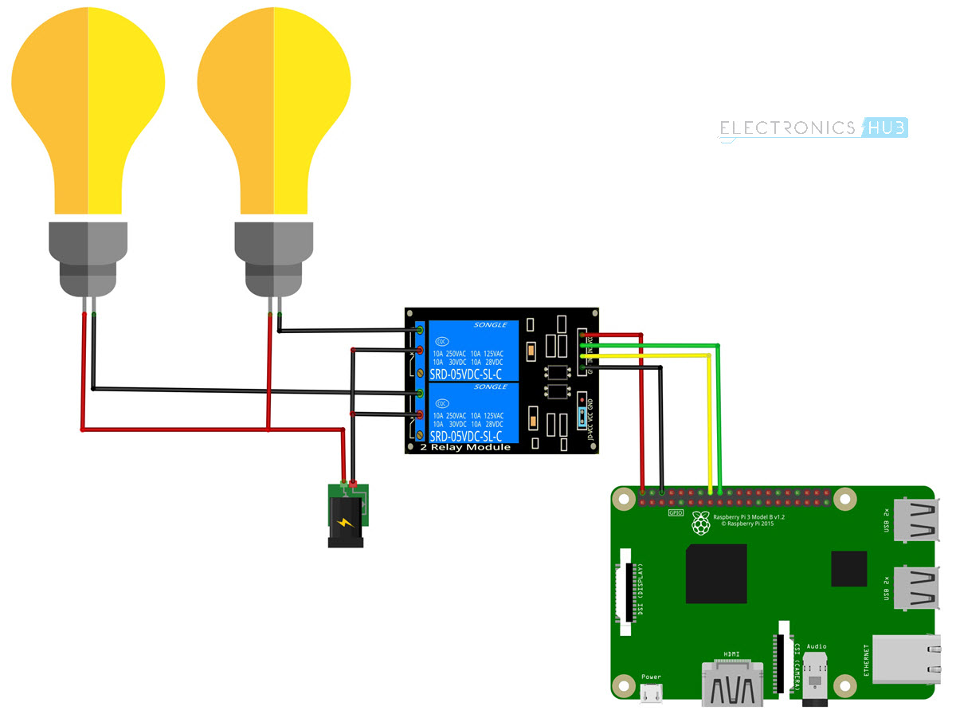
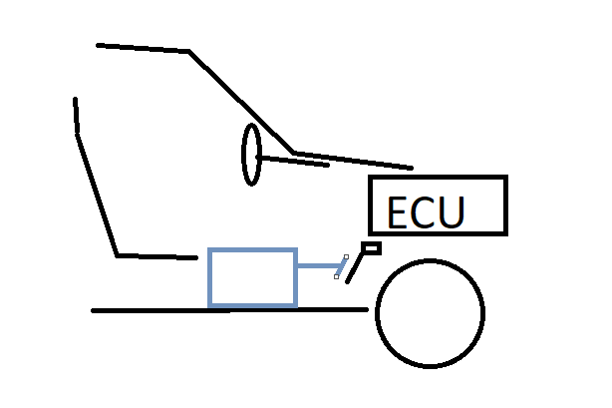
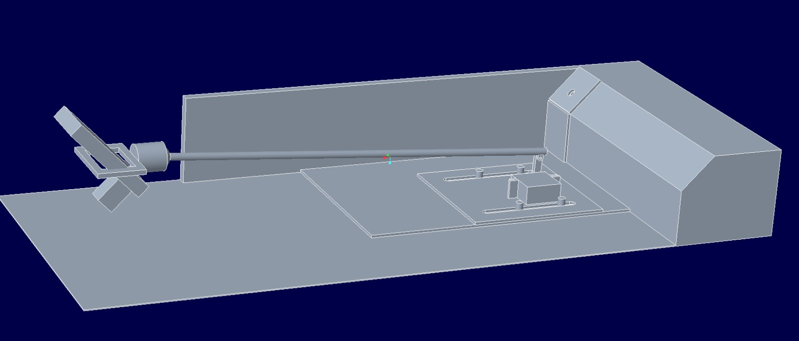
Guidelines for „Controllable driving robot for vehicle examinations on a roller test bench“ Project
Previous work (MiTOPS 2019):
Driving Speed Profile
Laboratory setup
Remote control over the Internet
User data

Slide 24
2. Project task, Group 2:
Development of a control system for the shifting of maual gears via a Cloud-IoT applicatio.
03.03.20
| 10

Slide 25

How can we work together between Germany and Malaysia?
How do we stay in touch?
How do we divide the work between us? Workflow?
How can everyone always be very well informed about the status of projects and members?

Slide 26
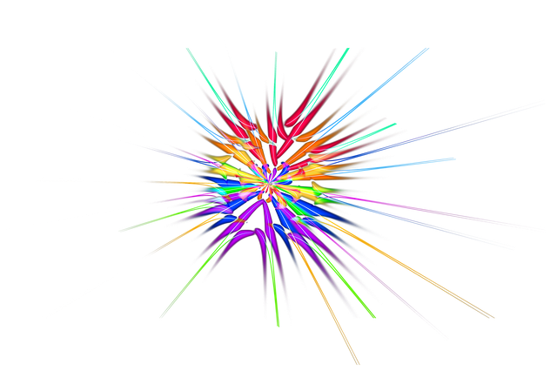



Solution…
03.03.20
| 10

Slide 27
What is GitHub?
It lets you and others work together on projects from anywhere.
GitHub is a website and cloud-based service:
Store,
manage,
track and
control changes of your project documents.
To understand exactly what GitHub is, you need to know two connected principles:
Version control
Git
03.03.20
| 10
https://kinsta.com/knowledgebase/what-is-github/

Slide 28

Software Publications
https://github.com/IKKUengine/SimulatedCPSLabVIEWEnergySystem
https://github.com/IKKUengine/EtaNetPythonClients
https://github.com/IKKUengine/ThreadedEtaNetServer
https://github.com/IKKUengine/MYiTOPS
GitHub.com/ikkuengine

Slide 29

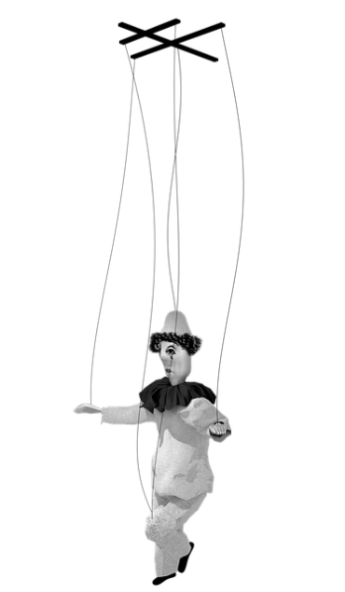
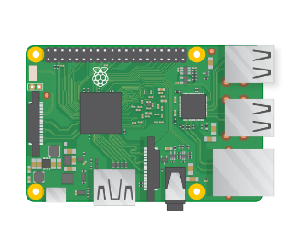
Server/
Cloud
let's make one or solder one.
Go to
https://github.com/IKKUengine/MYiTOPS
and read the README
Converting to digital object…
03.03.20
| <Foliennummer>

Slide 30
Dankeschön…
Contact
Ferhat Aslan
Institut für Kälte-, Klima- und Umwelttechnik
Tel.: 0721 925-1815
Raum M-U07
E-Mail: ferhat.aslan@hs-karlsruhe.de
Prof. Dr.-Ing. Maurice Kettner
Fakultät für Maschinenbau und Mechatronik
Tel.: 0721 925-1845
Raum F-111
E-Mail: maurice.kettner@hs-karlsruhe.de

